Slide 1

Welcome to Cub Scouting!
Pack ### - Best Elementary School

Slide 2
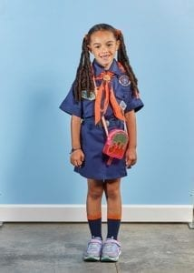
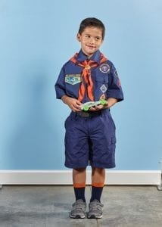
About Our Pack
Pack Meetings are held:
3rd Thursday of every month
Location of pack meetings
Pack website
Notes:
Hint: Do not read the slide

Slide 3
Our Scouts Have Fun!
[photos of our pack]

Slide 4
Pack Leadership
Adam, Cubmaster
  (314) 123-4567 / email@address.com
Laura, Committee Chair
  (314) 123-4567 / email@address.com
Joe, Kindergarten Den Leader
  (314) 123-4567 / email@address.com
Linda, 1st grade Den Leader
  (314) 123-4567 / email@address.com
Judy, 2nd grade Den Leader
  (314) 123-4567 / email@address.com
Melissa, 3rd grade Den Leader
  (314) 123-4567 / email@address.com
Mike, 4th & 5th grade Den Leader
  (314) 123-4567 / email@address.com

Slide 5
Join Online Tonight!
Sign-up for Cub Scouts here:
  [BeAScout.org Pack Signup URL]
Our first Pack Meeting will be:
  [date / location / time]

Slide 6
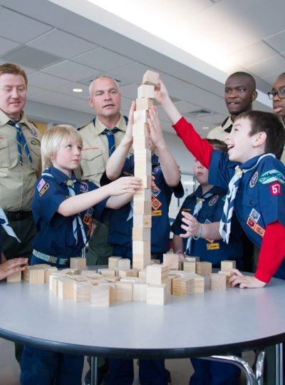
Thank You!
What questions do you have?
Thank you for joining us tonight!

